Slide 1



Withdrawal of pharmacological therapy for heart failure in recovered dilated cardiomyopathy – a randomised trial
TRED-HF
Embargoed until 10:45 a.m. CT/11:45 a.m. EST Nov. 11, 2018
Brian P Halliday MBChB PhD
Imperial College, London
On behalf of Sanjay K Prasad (PI), John GF Cleland (co-PI), Rebecca Wassall, Amrit Lota, Zohya Khalique, John Gregson, Dudley J Pennell, Stuart D Rosen, Martin R Cowie and the TRED-HF investigators
11th November 2018

Slide 2
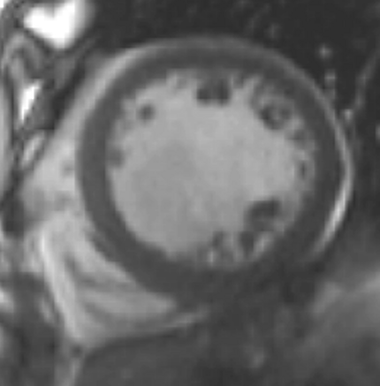
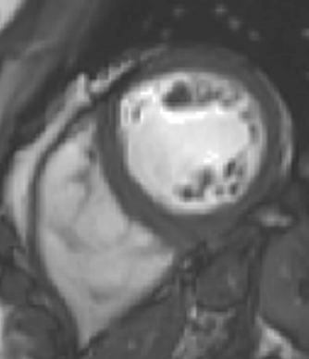
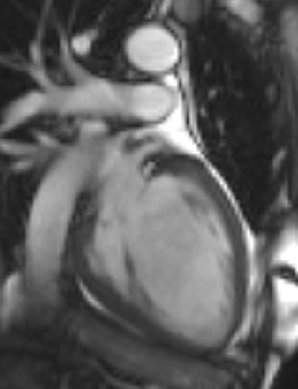
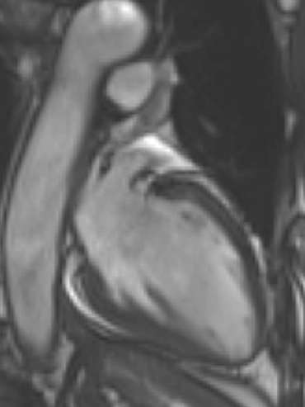
Dilated Cardiomyopathy: From Failure to ‘Success’
‘Do I need to take the medications forever?’
Side effects
Pregnancy
Financial constraints
Remission or cure?

Slide 3
TRED-HF
Open-label, pilot randomised trial
Examine safety and feasibility of phased therapy withdrawal
Recruitment from network of hospitals; enrolment in single centre
Prior diagnosis of DCM
  Dilated and LVEF<40% at diagnosis
Subsequent recovery
  LVEF>50%
  Normal LVEDVi
  NT-pro-BNP <250ng/L
  NYHA 1
Arrhythmia requiring beta-blocker
Uncontrolled hypertension
Valvular disease (moderate or greater)
eGFR<30mls/min
Pregnancy
Angina
Age <16 years
}
CMR

Slide 4
Screening visit
Clinical assessment, symptom questionnaires, NT-pro-BNP, CMR, CPET
Mimic what happens in clinical practice
Randomisation 1 to 1
Reduce/stop loop diuretics
Clinic review every 4 weeks
Clinical assessment and NT-pro-BNP
Interim telephone review
Reduce/stop MRAs
Clinic visit at 8 weeks
Clinical assessment and NT-pro-BNP
Continued therapy
Reduce/stop beta-blockers
Randomised
phase
Reduce/stop ACE inhibitors or ARB
16 week follow-up visit
Clinical assessment, NT-pro-BNP, CMR
6 month follow-up visit
Clinical assessment, symptom questionnaires, NT-pro-BNP, CMR, CPET
Therapy withdrawal using the same protocol
Single arm cross-over phase

Slide 5
Pre-specified end-points
Primary end-point
  Relapse of DCM defined by any 1 of:
Safety end-point
  (CV mortality, MACE, unplanned CV hospitalisation)
Arrhythmia end-point (sustained)
Changes in secondary clinical variables
Reduction in LVEF by >10% and to below 50%
Increase in LVEDV by >10% and to above normal range
Two-fold rise in NT-pro-BNP and to >400ng/L
Clinical evidence of heart failure
Immediate re-introduction of therapy

Slide 6
Patient Safety
Protocol approved by
  National Research Ethics Committee
  Medicines and Healthcare Products Regulatory Agency
  Institutional Oversight Committee and Patient Advisory Group
  Funding Body
  National Patient Organisations
24-hour contact with a doctor
General practitioners and physicians kept up-to-date
All trial data reviewed weekly
  AEs managed on an individual case basis
Independent data monitor

Slide 7
Randomised phase
21 Apr 2016 to 22 Aug 2017
Screening visit (n=63)
Randomised (n=51)
Randomised to therapy withdrawal (n=25)
Randomised to continued therapy (n=26)
Withdrew from study (n=1)
Completed planned follow-up (n=24)
Completed planned follow-up (n=26)
Restarted therapy without meeting the primary end-point for NSVT (n=1)
25 pts randomised to therapy withdrawal
vs
26 pts randomised to continued therapy
ITT Primary
analysis

Slide 8
Baseline
 | Therapy Withdrawal (n=25) | Control (n=26)
Demographics
Median Age (IQR), yrs | 54 (46,64) | 56 (45,64)
Men, n (%) | 16 (64) | 18 (69)
Previous cardiovascular history
Time since initial DCM diagnosis, months | 63 (36,112) | 41 (20, 91)
LVEF at initial diagnosis, % | 28 (20,33) | 25 (19,33)
Absolute improvement in LVEF, % | 29 (23,36) | 30 (25,38)
Time since LVEF>50%, months | 28 (8,45) | 20 (6,44)
Previous heart failure admission, n (%) | 18 (72) | 14 (54)
Previous moderate alcohol excess, n (%) | 8 (32) | 9 (35)
Previous atrial fibrillation, n (%) | 8 (32) | 4 (15)
Aetiology
Idiopathic, n (%) | 20 (80) | 15 (58)
Familial, n (%) | 3 (12) | 4 (15)
Environmental insult, n (%) | 2 (8) | 7 (27)
TTNtv, n (%) | 7 (28) | 4 (15)
Medications at enrolment
ACE inhibitor /ARB, n (%) | 25 (100) | 26 (100)
Beta-blocker, n (%) | 21 (84) | 24 (92)
Mineralocorticoid receptor antagonist, n (%) | 12 (48) | 12 (46)
Loop diuretic, n (%) | 3 (12) | 3 (12)
Clinical characteristics at enrolment
Heart rate, beats per minute | 62 (58,74) | 70 (60,75)
Systolic blood pressure, mmHg | 123 (117,133) | 127 (117,134)
Diastolic blood pressure, mmHg | 72 (68,80) | 76 (70,80)
Left bundle branch block, n (%) | 3 (12) | 4 (15)
QRS duration, ms | 98 (85,108) | 94 (88,111)
NT-pro-BNP, ng/l | 72 (44,147) | 75 (37,133)
CMR variables at enrolment
LVEDVi, ml/m² | 86 (66, 91) | 80 (70,91)
LVEF, % | 62 (55, 66) | 60 (55,61)
Median age: 55 years (IQR 45 to 64)
34 (67%) men
At first diagnosis
  Median LVEF: 25% (IQR 20 to 33)
  Median time from diagnosis: 4.9 yrs (IQR: 2.1 to 8.3)
At enrolment
  All in sinus rhythm
  Median LVEF: 60% (IQR 55 to 64)
  Median NT-pro-BNP: 72ng/L (IQR 39 to 135)
All patients on ACEi/ARB
45 (88%) on beta-blocker
24 (47%) on MRA
6 (12%) on loop diuretic
1 pt had CRT-D and 1 pt an ICD in situ

Slide 9
Results
Randomised phase
Arm | Pts | Relapse n (%)
Therapy withdrawal | 25 | 11 (44)
Control | 26 | 0 (0)
Single-arm cross-over phase
Arm | Pts | Relapse n (%)
Therapy withdrawal | 25 | 9 (36)
  Further 3 restarted therapy
    2 for hypertension, 1 for AF
Of 50 pts who began therapy withdrawal, 20 (40%) met primary end-point
25 of 50 (50%) patients completed follow-up without re-initiation of treatment
16 of 50 (32%) completed withdrawal without deterioration in LVEF (>3%)

Slide 10
Primary end-point components
NT-pro-BNP
n=1
Clinical
n=1
n=2
n=2
n=3
n=4
n=2
n=5
LVEDV
LVEF

Slide 11
Safety end-points
No deaths, unplanned heart failure hospitalisations or MACE
3 serious adverse events in withdrawal arm
  Hospitalisations: urinary sepsis, non-cardiac chest pain and an elective procedure
No sustained ventricular arrhythmia or device therapies
Three pts developed AF in withdrawal arm
All pts who met primary end-point were asymptomatic at follow-up
  17 of 20 pts had LVEF>50%
  2 had LVEF 45-50% and 1 had LVEF 43%

Slide 12
Secondary end-points
Randomised comparison of baseline and follow-up variables
Withdrawal vs control in randomised phase
Baseline vs follow-up variables for
all those who had treatment withdrawal
Outcome | Estimated mean effect of therapy withdrawal on 6-month values (95% CI) | P value
LVEF, % | -9·5 (-14·0 to -4·9) | 0·0001
LVEDVi, ml/m² | 4·7 (-1·5 to 11·0) | 0·14
LAVi, ml/m² | 0·5 (-4·2 to 5·2) | 0·82
Heart rate, bpm | 15·4 (10·0 to 20·9) | <0·0001
Systolic BP, mmHg | 6.6 (-0.1 to 13.4) | 0.055
Diastolic BP, mmHg | 7·0 (1·9 to 12·1) | 0·008
Log NT pro-BNP, ng/L | 0·3 (-0·1 to 0·7) | 0·11
Peak VO₂ (ml/kg/min) | -1·2 (-3·9 to 1·6) | 0·40
Exercise time (secs) | -3·4 (-36·0 to 29·2) | 0·83
KCCQ, 0-100 | -5·1 (-9·9 to -0·4) | 0·035
SAQ, 0-100 | 0·3 (-0·1 to 0·6) | 0·15
Outcome | Estimated mean change between baseline & 6 months (95% CI) | P value
LVEF, % | -6·9 (-9·6 to -4·3) | <0·0001
LVEDVi, ml/m² | 6·5 (3·1 to 9·8) | 0·0003
LAVi, ml/m² | 2·0 (-0·6 to 4·6) | 0·12
Heart rate, bpm | 13·2 (9·3 to 17·1) | <0·0001
Systolic BP, mmHg | 8·7 (4·6 to 12·9) | 0·0001
Diastolic BP, mmHg | 6·7 (3·2 to 10·1) | 0·0003
Log NT pro-BNP, ng/L | 0·3 (0·0 to 0·6) | 0·025
VO₂ max (ml/kg/min) | -0·7 (-2·1 to 0·7) | 0·33
Exercise time (seconds) | -0·6 (-14·9 to 13·8) | 0·94
KCCQ, 0-100 | -2·2 (-4·7 to 0·3) | 0·078
SAQ, 0-100 | 0·1 (-0·1 to 0·3) | 0·38
ANCOVA
Paired T test

Slide 13
Exploratory analyses
Association between baseline characteristics and primary end-point
Characteristic |  |  | Hazard ratio (per SD change unless specified) | P value
Age (per 10 yrs) |  |  | 1·6 (1·0 to 2·4) | 0·031
MRA |  |  | 3·9 (1·4 to 10·8) | 0·004
Number of HF medications | ≤2 agents | ≤2 agents | 1·0 (reference) | 0.004
 | 3 agents | 3 agents | 3·7 (1·3 to 10·6)
 | 4 agents | 4 agents | 4·8 (1·1 to 20·2)
Log NT-pro-BNP, ng/L |  |  | 1·8 (1·1 to 2·8) | 0·016
Global radial strain |  |  | 0·55 (0·34 to 0·90) | 0·018

Slide 14
Conclusion
Withdrawal of pharmacological heart failure therapy from patients deemed to have recovered DCM resulted in relapse in ~40% of cases
  Likely to be greater in medium- and long-term
Withdrawal of therapy should not usually be attempted, until
  Predictors of relapse are defined
  Better understanding of importance of specific therapies
  Monitoring in place
Improvement in function represents remission rather than permanent recovery for many patients

Slide 15




Acknowledgements
TRED-HF Investigators
Sanjay K Prasad (PI)
John GF Cleland (co-PI)
Martin R Cowie
Stuart D Rosen
Dudley J Pennell
Stuart A Cook
A John Baksi
Rebecca Wassall
Amrit S Lota
Zohya Khalique
John Gregson
Simon Newsome
James S Ware
Tsveta Rahneva
Robert Jackson
Rick Wage
Gillian Smith
Lucia Venneri
Upasana Tayal
William Midwinter
Nicola Whiffin
Dominique Auger
Ronak Rajani
Jason Dungu
Antonis Pantazis
Patients

